Slide 1

Real Time Operating System
Lecture (1)
RTOS Concepts
This material is developed by IMTSchool for educational use only
All copyrights are reserved

Slide 2

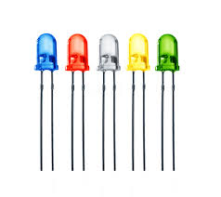
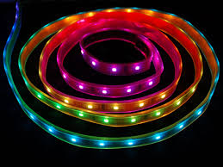
Super Loop(BackGround)
Consider we have 5 LEDs and each one has a blinking time (1 , 1.5 , 0.5 ,5 , 3.5)ms respectively what would we do to design this system ... ?
We can use a timer which fires every 0.5 ms. Inside the ISR we can increment a counter. According to the counter value we will blink the LEDs in a super while(1) loop.
What if we have 100 LEDs and every one has a different blinking time … ?
It will be more complex now to Synchronize between LEDs right !

Slide 3
Operating System
The Operating System is a system which takes number of Tasks and perform them in a specific time called Periodicity. Task is nothing but a piece of code that repeated every specific time. Every task has its own periodicity . The OS will Synchronize between these task Simply.
Task(1)
Task(3)
Periodicity(1)
Periodicity(3)
Operating
System
Task(2)
Task(n)
Periodicity(2)
Periodicity(n)

Slide 4
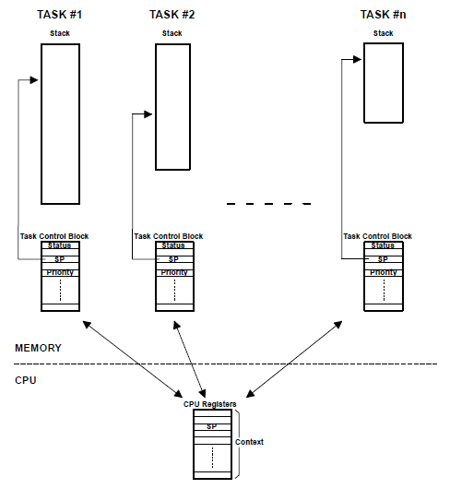
Multitasking
Multitasking is a process of scheduling and switching the Central processing unit (CPU) between several tasks .
A single CPU switches its attention between several sequential tasks
Application programs are typically easier to design and maintain if multitasking is used.

Slide 5
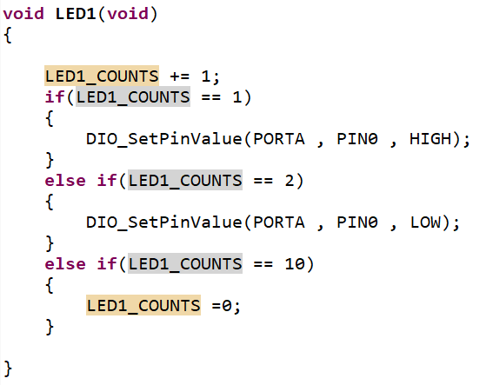
TASK
Task, or also called a thread, is a simple program that thinks it has the CPU all to itself.
Task is a function which Takes void and returns void only contains some lines of codes. Every task could be periodic task .
Now every LED will be a Task and the OS will Sync between them.

Slide 6
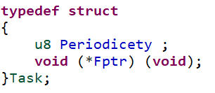
TASK parameters
Tasks have main three parameters:
The function (pointer to function)
The Periodicity
The Priority
The lines of code that will be executed by CPU.
The periodic time of the task to be executed .
the more importance the task , the higher priority given to it .
The priority of the Task will take place later.

Slide 7
Task States
Each task can be in any one of five states .
Dormant
Task that resides in memory but has not been passed to the RTOS to start scheduling.
Ready
Task that can execute but its priority is less than the currently running task
Running
ISR
Waiting
Task that has the control of CPU.
Task that requires the occurrence of an event.(for ex “waiting for an I/o operation”
When an interrupt has occurred and the CPU is in the process of service the interrupt

Slide 8
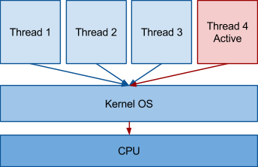
Kernel
A kernel is the part of multitasking system that software which responsible for management of tasks (managing the CPU time) and communicate between them.
The use of Real-time Kernel Simplify the design of the system by allowing the application to be divided into multiple tasks that the kernel manages.

Slide 9
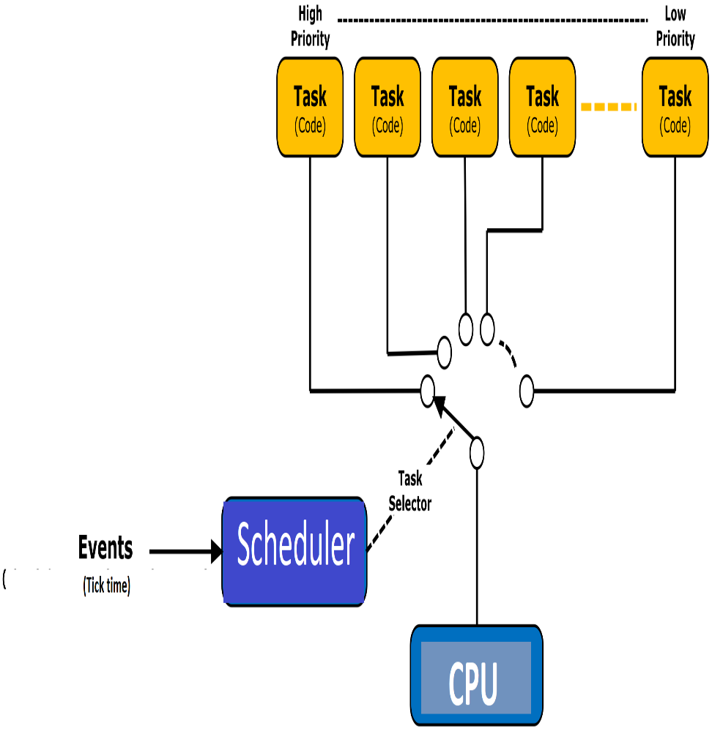
Scheduler
Scheduler : also called dispatcher , is the part of the kernel responsible for determining which task runs next.
Most Real time Kernel are priority passed.
Each task is assigned a priority based on it’s importance.
the priority of every task is application specific.
In a priority based kernel ,control of the CPU is always given to the highest priority task ready to run .
The Scheduler runs every a specific time called TICK time.
Two types of priority based kernel exist:
Preemptive kernel
Non-preemptive Kernel

Slide 10
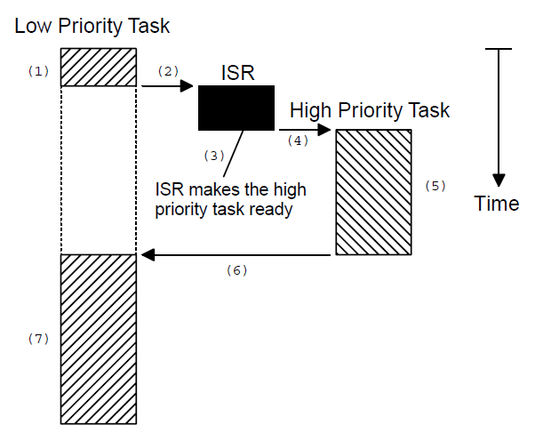
Preemptive kernel
A preemptive kernel is used when system responsiveness is important.
The highest priority task ready to run is always given control of the CPU .
The most commercial Real time Kernels are preemptive .
If the ISR a higher priority task ready , when the ISR completes , the interrupt task is suspended, and the new higher priority task is resumed

Slide 11
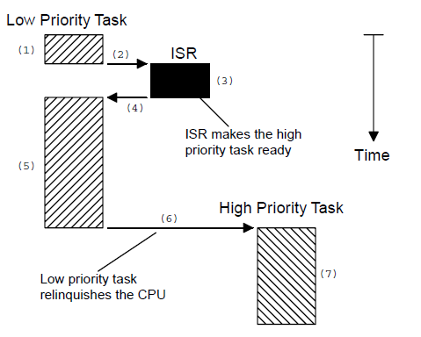
Non-Preemptive kernel
Non-preemptive kernel requires that each task does something to explicitly give up control of the CPU
The ISR can make a higher priority task ready to run , but the ISR always returns to the interrupted task. The new higher priority task gains control of the CPU only when the current task give up the CPU.

Slide 12
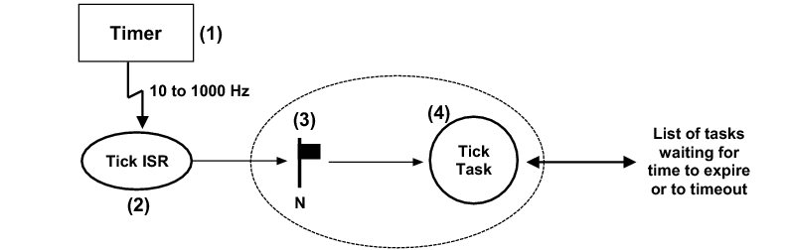
TICK time
Tick time is that time which the Scheduler takes place.
Tick time must be suitable for all tasks.
Consider that we have a scheduler with Tick time (1ms) and we have three tasks will run at next Tick every one of them takes 500us to be performed .
The scheduler will ignore the third task As if it did not exist and perform another one at next tick and that is a Disaster
T1
T2
T3
time
T
I
C
k
0.5ms
T
I
C
k
1ms

Slide 13
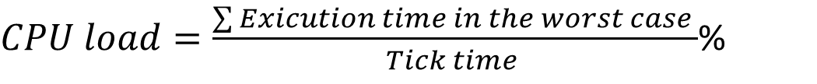
CPU load
CPU load is one of the most important parameters in the OS .
CPU load is that how much is the CPU busy between two ticks.
CPU load could be determined by a simple equation.
$CPU load=\frac{\sum{Exicution time in the worst case }}{Tick time }$%
Notes
CPU load have to be less than 100%.
The lower the CPU load the better the system
It is better for a CPU load to be between 60% and 80%.
The tick time must be greater than the greatest execution time of a task.

Slide 14
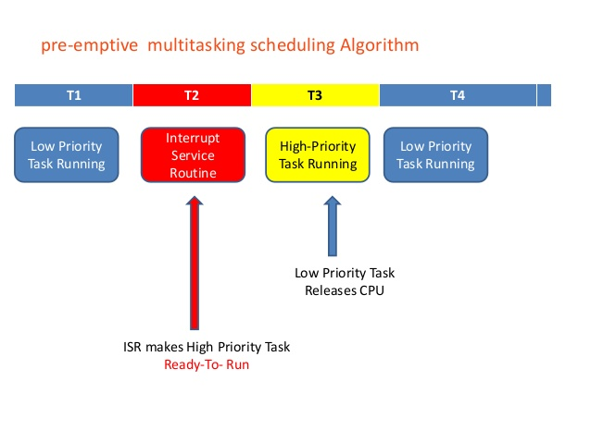
priorities
Task Priority
Static Priority
Dynamic Priority
A priority is assigned to each task . the more importance the task , the higher priority given to it .
Task priorities are static when the priority of each task does not change during the execution time . Each task is given a fixed priority at a compile time.
Task priorities are dynamic if the priority of the task can be change during the run time this feature is used is used in Real-time kernel to avoid priority inversion(will discussed later)

Slide 15
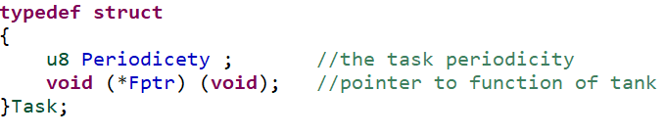
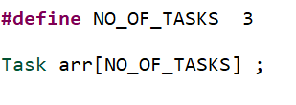

let’s implement our own simple RTOS
Task Definition
We need to define a New struct for the task with it’s parameters.
Array of Tasks
We need to configure n array of the maximum no of tasks that system can handle.
The priority of every Task will be its Index in the array .

Slide 16
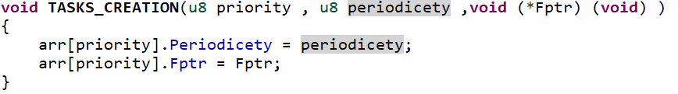
let’s implement our own simple RTOS
Create task
We need to implement a function that create new task and fill the tasks’ array by it’s parameters .

Slide 17
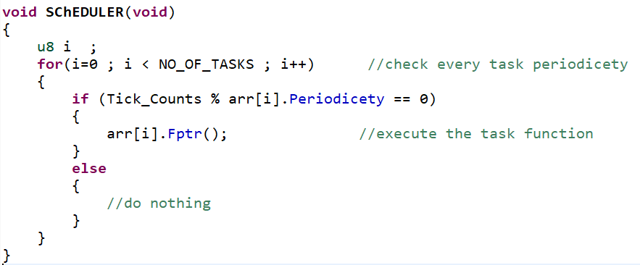
let’s implement our own simple RTOS
Scheduler
We need to make a function which decide which Task will be executed .

Slide 18
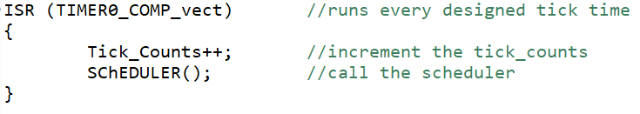
let’s implement our own simple RTOS
Tick time
We need to adjust a timer to configure the required tick time .

Slide 19

Lab 1
Design a system with these constrains:
RED LED blinks every 1ms.
Yellow LED blinks every 2ms.
Green LED blinks every 5ms.
Stepper motor steps every 30ms.
LCD Shifts your name right every 100ms.

Slide 20


www.imtschool.com
ww.facebook.com/imaketechnologyschool/
This material is developed by IMTSchool for educational use only
All copyrights are reserved

